Slide 1
Team 06: KNU MOVIE
COMP322002 Introduction to Databases (Fall’20)
Team members: Sangmin LEE, Sangjun Ahn, Gihyun Kim

Slide 2
Contents
Individual Role
Project Description
  Functionalities
  Scenarios
  Summary of Project Code
Demo
Lesson

Slide 3
Role Summary
Sangmin LEE : Search, Rating Movie, Recommend Service, Admin Service
Sangjun Ahn : Manager Account & Movie, Recommend Service, Admin Service
Giyhun Kim : Admin Service, Account Service, Homepage Service

Slide 4
Project Description
  Homepage show Movie with image file & completely success Phase3’s functions
  Evaluation criteria:
    Web support of required functionalities developed in Phase 3: O
    Concurrency control support: X
    Recommendation service: O
    Source code repository: O
    README file: O

Slide 5
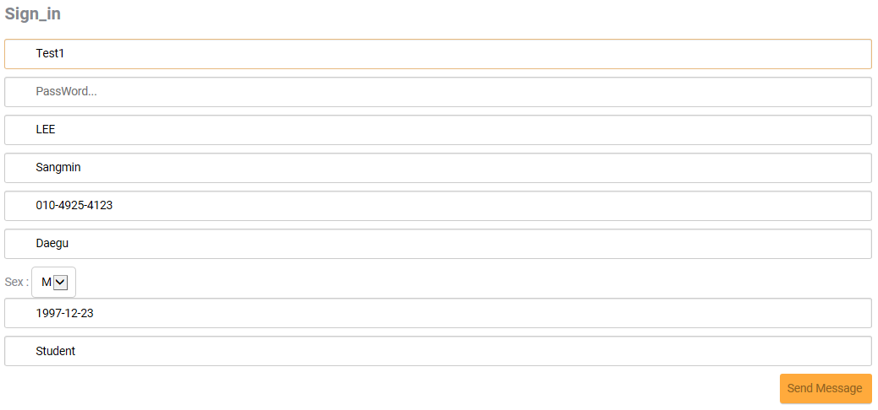
Functionality support
(scenarios)
1. Sign_in
Click ‘Sign_in’ Button & Fill Sign_in Field
If ID is already exist, alert!

Slide 6
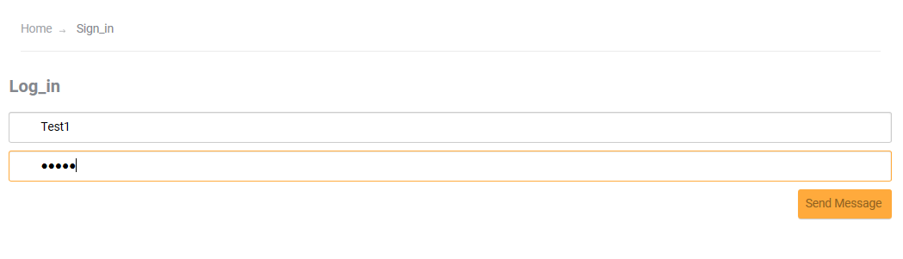
Functionality support
(scenarios)
2. Login
Click ‘Login’ Button & input Log_in Field
If ID or Password is wrong, alert!

Slide 7
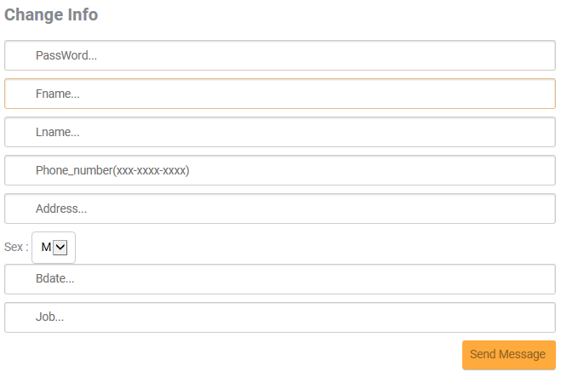
Functionality support
(scenarios)
3. Change_Myinfo
After Login, Click ‘Myinfo’ button
Click ‘회원정보수정’ button & Fill Change Info Field

Slide 8
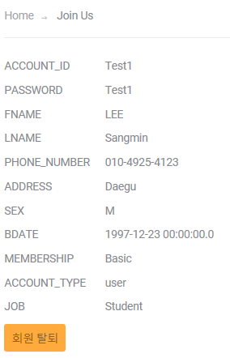
Functionality support
(scenarios)
4. Withdraw from membership
After Login, Click ‘Myinfo’ button
Click ‘회원탈퇴’

Slide 9
Functionality support
(scenarios)
5. Show Movie List(With Search)
You can search with or with out Login
Search List : (Title, Type, Genre, Version)
Search basically show ‘OR’ option List
If you search anything, you can get list of movie without rated movie

Slide 10
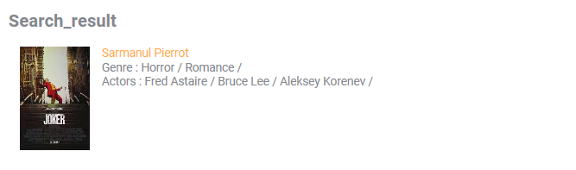
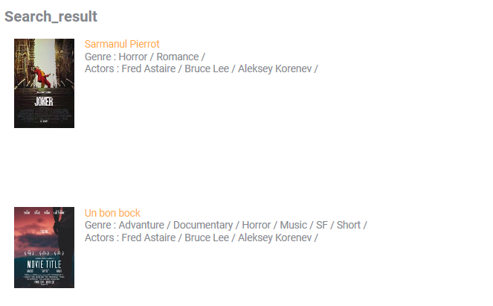
Functionality support
(scenarios)
5. Show Movie List(With Search) (Continue…)
Search Value : Sarmanul Pierrot, Horror
Search Value : Horror

Slide 11
Functionality support
(scenarios)
5. Show Movie List(With Search) (Continue…)
Recommend Search Value : Romane, SF (Genre, Genre)
Recommend Search Value : KR (Version)
Recommend Search Value : Movie, Romance (Type, Genre)
Recommend Search Value : Carmencita, Le clown et ses chiens (Title, Title)

Slide 12
Functionality support
(scenarios)
6. Movie rate
In Movie_info page, rate the Movie and click ‘Rate’ button
If Movie was rated, not show ‘Rate’ button

Slide 13
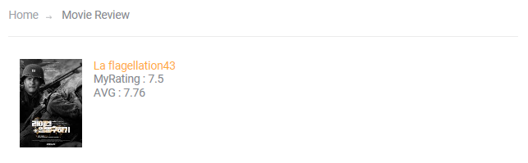
Functionality support
(scenarios)
7. Movie Review(Show my rating)
After rated movie, Click ‘Review’ button
Can show MyRating & AVG Rating
If Click Movie img or Title, Can show Movie_info

Slide 14
Functionality support
(scenarios)
8. If Admin
ID: ukHyQ3832
Password : lhY449
Basically, Admin can use all of account’s function

Slide 15
Functionality support
(scenarios)
8. If Admin(Continue…)
If want check all of rating, Click ‘Review’ button

Slide 16
Functionality support
(scenarios)
8. If Admin(Continue…)
Click ‘Admin_mode’ button & Click ‘Upload New Movie’
Fill Upload New Movie Field
Fill Actor & Version Field
Input img file to movie_input Folder

Slide 17
Functionality support
(scenarios)
8. If Admin(Continue…)
Click ‘Admin_mode’ button & Click ‘Modify Movie’
Fill Change Movie Field

Slide 18

UI Design
1.Menu bar
Menu bar is Designed with JSP and each Menu link with another JSP
Can automatically change(if login or if admin)

Slide 19
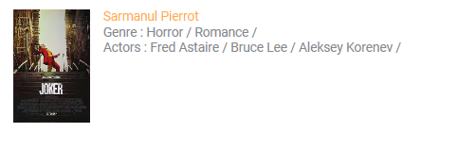
UI Design
2.Search or Review page
Img or Title is designed with JSP, link with Movie_info JSP
In Project, all of img is linked with Movie_info JSP

Slide 20
Summary of Project Code: Environment Settings
Code development environment
  Total line of code: At least 5,500 LINES
  OS: Window 10
  DBMS: Oracle
  Language: Java
  IDE: Eclipse(jdk-15.0.1) & Apache Tomcat v8.5 & ojdbc7.jar
  Github URL: https://github.com/Girin7716/KNUMovieDB

Slide 21
Demo
https://www.youtube.com/watch?v=UZwzqdtpTwg&ab_channel=%EC%95%88%EC%83%81%EC%A4%80

Slide 22
Lessons
This project, we can learn create web page with JSP & How to use DBMS in web page
Can perfectly manage Oracle & design web page

Slide 23
Q & A

